Slide 1
Treating the Complex Psychiatric Patient
Marie Cugini Schur, Ph.D., Department of State Hospitals - Atascadero
Charles Broderick, Ph.D., Department of State Hospitals - Sacramento
Darci Delgado, Psy.D., Department of State Hospitals - Vacaville
Kate Warburton, M.D., Department of State Hospitals - Sacramento

Slide 2
Complex Case Example
Mr. C. had a long history of mental health symptoms, including psychosis, aggression, and low cognitive functioning. As with many difficult cases at DSH-Atascadero, his diagnosis was:
Schizoaffective Disorder, Bipolar Type
Antisocial Personality Disorder
Polysubstance Dependence
Borderline Intellectual Functioning

Slide 3
Complex Case Example
History:
Significant history of child abuse (sexual abuse by mother, foster care)
Behavioral difficulties (defiance) in early childhood, psychosis in late teens
Two suicide attempts in prison by cutting his wrists
History of fairly significant alcohol abuse
Self-reported gang involvement
Controlling offense was a rageful assault against a female police officer (later stated he “blacked out”)
Other assaults against female staff once hospitalized

Slide 4
Complex Case Example
Current Presentation:
Appears “larger than life” and “menacing” on the units
Obsessed with hatred of particular ethic and protected groups, especially his own ethnic group
Constantly tests boundaries; difficulties with authority
Recognizes that he has a mental illness (fairly unusual)
Referred to a specialized unit within DSH-Atascadero

Slide 5
Complex Case Example
Treatment priorities for this case?
Essential treatment elements for this case?

Slide 6
Complex Case Presentation
Treatment Priorities
Take home point: They are all important
Very difficult to argue that one treatment priority is more important than the next
Must treat aggression, self-harm, psychosis, trauma, and trust at the same time
If outpatient, add substance abuse to that list
Focus on generalized essential treatment elements
**Disclaimer

Slide 7
California State Hospital Background
Why does DSH see many complex and violent patients?
Societal:
Criminalization of the mentally ill
Lack of community resources
Patients admitted are “sicker”
Media Attention
Decreases morale of staff
Somewhat sensationalized
Diabetic patients have higher blood sugar!!
(D. Fennell, Medical Director, DSH-A)
Organizational:
State hospitals accept more forensic patients than in the past
Less conservatees

Slide 8
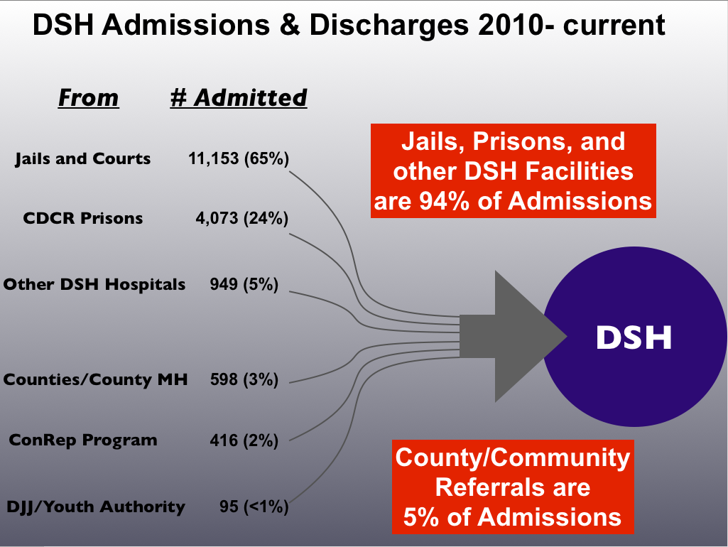

Slide 9
Headline 1
State mental hospitals remain violent, despite gains in safety

Slide 10
Headline 2
California state mental hospitals plagued by peril

Slide 11
Headline 3
The Violent Patient Population Inside State Mental Hospitals
"This hospital [DSH-Napa] has turned into a de facto prison"

Slide 12
California State Hospital Background
Legal/Policy:
Involuntary Medication
Current: All commitments need a court order
Past: Almost every patient was able to be forced medicated
Restraint and seclusion
Current: restrained for hours, “imminently dangerous”
Past: restrained for days
MDO parole revocation
Current: MDOs return to prison only with new serious charge (e.g., broken bones), but never revoked
Past: Could revoke MDO’s parole

Slide 13
California State Hospital Background
Patients:
~25% treatment resistant
Most are not aggressive
~28% have ever been aggressive
~12% aggressive in the past year
Types of aggression: organized, psychotic, impulsive
DSH-A most severe patients:
~ 33% due primarily to psychosis (“Psychotic” e.g., command hallucinations, mania)
~ 33% due primarily to personality structure (e.g., “Organized” Antisocial Personality Disorder/Psychopathy or Borderline Personality Disorder)
~ 33% due primarily to cognitive limitations/other (“Impulsive” e.g., dementia, mental retardation, institutionalization)
More complex patients will have multifacted etiologies for violence

Slide 14
Motivations for Aggression
With our most difficult patients, there is typically more than one motivation and the motivation changes from incident to incident
(below ranked in order of importance)
SIR #1 | Paranoid | Testing Boundaries | Impulsive | Unable to Verbalize needs | Asserting Dominance | Anti-Authority | Avoidance | Borderline Per. Dis.
SIR#2 | Psychotic | Testing Boundaries | Asserting Dominance | Anti-Authority | High Emotionality
SIR#3 | Impulsive | Cognitive | Planned
SIR#4 | Voices | Paranoid | Impulsive | Felt Disrespected | Asserting Dominance
SIR#5 | Testing Boundaries | Impulsive | Asserting Dominance | Seeking Attention | Other

Slide 15
Effects of Working with Complex Patients
What are some effects on the staff in working with complex, violent patients?
How about on the patients themselves?

Slide 16
Effects of Working with Complex Patients
Effect on staff
Low morale
Labeling, attributing behavior to volitional process
High rate of burnout
Higher potential for abuse
Effect on patient
Identifies as the “bad one”
Likely to be institutionalized
Maladaptive behaviors to get needs met
Poor inherent reinforcement to change

Slide 17
Utility of Psychological Tools
Diagnosis
How useful is a diagnosis?
Uncertainty with which diagnosis to treat first
Diagnosis doesn’t capture clinical presentation
Categorical approach v. Dimensional approach
Recommendation:
Diagnose, but then place it to the side

Slide 18
Utility of Psychological Tools
Manualized Treatments
How useful are manualized empirically-supported treatments?
Unclear which treatment to choose
Unclear if treatment will work with so many comorbid conditions
Based in research with those who only have that condition
If it fails, therapist may classify treatment as ineffective
Recommendation:
Combine elements of many treatments
Modify treatments to meet the needs in front of you
Use of creativity

Slide 19
Utility of Psychological Tools
Assessment
High chance of invalid profile
Recommendations:
Useful as a guide but limited

Slide 20
Steps for Treating Complex Patient
…So how does one treat a complex patient in a complex setting????
1. Common Factors (Bergin & Garfield, 1994; Lambert, 1992)
2. Look for therapies that work on multiple disorders
3. Combine Specific Elements
4. Look for common themes
5. Be creative

Slide 21
Common Factors
Different therapies → same goal
Common factors:
Support
Learning
Action

Slide 22
Common Factors - Support
Support
Process:
Catharsis
Mitigation of isolation
Reassurance
Structure
Relationship:
Therapeutic alliance
Positive relationship
Trust

Slide 23
Common Factors - Support
Support:
Patient:
Identification with therapist
Release of tension
Therapist:
Therapist/client active participation
Therapist expertness
Therapist warmth, respect, empathy, acceptance, geninueness

Slide 24
Common Factors - Learning
Learning
Advice
Affective experiencing
Assimilation of problematic experiences
Changing expectations for personal effectiveness
Cognitive learning
Corrective emotional experience
Exploration of internal frame of reference
Feedback
Insight
Rationale

Slide 25
Common Factors - Action
Action
Behavioral regulation
Cognitive mastery
Encouragement of facing fears
Taking risks
Mastery efforts
Modeling
Practice
Reality Testing
Success experience
Working through

Slide 26
Specific Elements
What are the elements of the presenting problem?
Borderline Personality Disorder, Schizophrenia, Mental Retardation
Dialectical Behavioral Therapy elements
Mindfulness elements
CBT for Psychosis elements
Presented at a lower cognitive level
Not hierarchical, but comprehensive/Gestalt

Slide 27
Look for treatments that are generally useful
Motivational Interviewing, Cognitive Behavioral Therapy are useful for many disorders

Slide 28
Motivational Interviewing
Motivational Interviewing (MI) translates to many different diagnoses.
MI is directive, client-centered and elicits behavior change by helping individuals to explore and resolve ambivalence.
MI helps people figure out ways to reduce problem behavior and increase healthy behavior.

Slide 29
MI Philosophy
Autonomy
Responsibility for change is left with the individual.
The individual is always free to take advice or not.
The individual comes up with the arguments for change.
MI does not endorse confrontation as a way to break down denial.
Collaboration with therapist
Eliciting
Helping the individual to find things from within and drawing them out.

Slide 30
Four Principles
Express Empathy
A real desire to understand and connect with how another person feels
Develop Discrepancy
People can be motivated to change when they recognize the difference between what they are doing and what they believe they should be doing.
Roll with Resistance
Resistance, in its most basic sense, is a reluctance to change, which is natural and normal.
Resistance may indicate ambivalence and often stems from fear of change.
Direct persuasion or arguments are ineffective for motivating change.

Slide 31
Support Self-efficacy
Self-efficacy is the sense of being able to achieve one’s goals effectively.
Helping people to discover the belief that they will be successful if they try is another key to motivating change.
The staff’s own belief in the individual’s ability to change becomes a self-fulfilling prophecy.

Slide 32
MI Techniques
Use reflective listening.
Engage by discussing issues important to the individual.
Focus on building the relationship rather than getting the person to change. (Come alongside)
Emphasize that change is always their choice.

Slide 33
Trauma-Informed Therapy

Slide 34
Trauma-Informed Therapy

Slide 35
Patterns and Trends
How are the disorders linked?
How is depression and psychosis similar? How do they effect each other?
How are DBT and DBT for psychosis similar??

Slide 36
Importance of Creativity
….
Examples:

Slide 37
Example of Complexity Failure
Mr. P. (age 27) has experienced depression “for as long as he can remember.” He has frequent suicidal ideation, 2 previous attempts (last one, 3 years ago). Mr. P. identifies excessive alcohol consumption beginning at age 18. His current diagnoses are Major Depressive Disorder and Alcohol Dependence. He was treated in an outpatient rehabilitation program for alcohol dependence.

Slide 38
Example of Complexity Failure
Mr. P. very much wanted relief from suffering and worked hard in his abstinence program. After a few relapses, he remained consistently sober. After an initial period (“honeymoon” period), his depressive symptoms seemed to worsen. He was no longer able to leave the house. Tasks seemed overwhelming. His personal relationships were deteriorated and he was loosing weight rapidly.

Slide 39
What happened?
What could have been done differently?
What treatment would you offer?

Slide 40
Case Example 1

Slide 41
How would you treat this patient?

Slide 42
Case Example #2

Slide 43
How would you treat this patient?

Slide 44
Case Example #3

Slide 45
Case Example #4

Slide 46
Case Example #5

